Slide 1
Git & Github
Cooper Union Summer STEM - Robotics Crash Course

Slide 2
What is Git?
Git is a “distributed version-control” system. It’s goal is to track all changes to a set of files, typically source code (source code is human readable code).
It has a set of commands that you can execute to update the set of files.
It also has commands that can let you interface your local set of files (called a local repository) with a repository that exists on a server online (GitHub for example).
Notes:
Version control system means that its goal is to track and record every change in a set of text files.
What this allows you to do is check every change to a file, when it occurred, and if needed, recover previous versions of the file.
Distributed means that these tracked files can be stored on many different computer systems, such as a local computer, remote servers (like GitHub), etc.

Slide 3
What is GitHub?
GitHub, is a web interface to git.
GitHub is a code hosting platform for version control and collaboration. It lets you and others work together on projects from anywhere.
Notes:
It allows you to perform the most important functions of git through a friendly and easy to use graphical interface, adding some handy project management and sharing features.

Slide 4
...But What’s the Difference?
GIT is a version control system, or basically a tool to manage your code history, while GitHub is a hosting service for GIT repositories.
In short, GIT is a tool, and GitHub is a service for projects that use GIT.

Slide 5
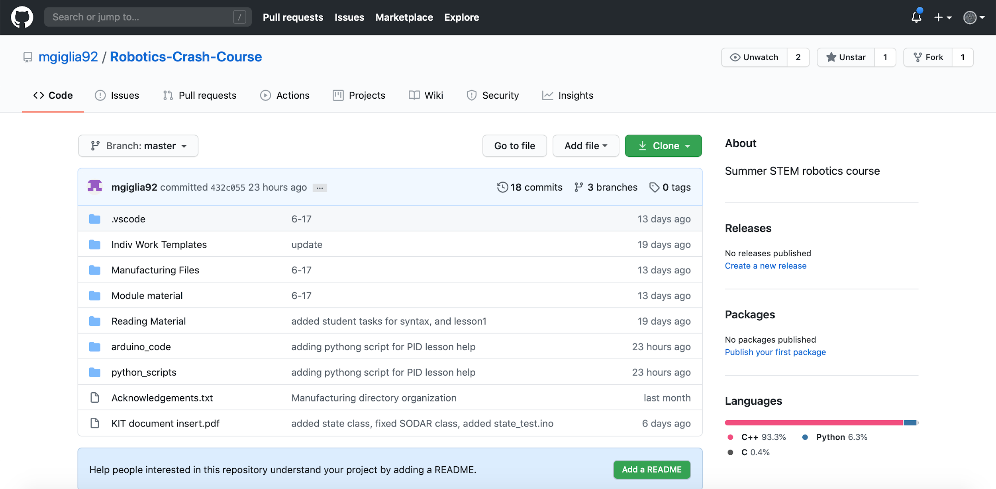
What is a Repository?
A repository is usually used to organize a single project.
Repositories can contain folders and files, images, videos, spreadsheets, and data sets – anything your project needs.

Slide 6
What is a Commit?
The act of saving changes or “creating a snapshot” is called a commit.
Each commit has an associated commit message, which is a description explaining why a particular change was made.
Notes:
Git tracks changes to a file through the use of commits.
When you commit changes, you are effectively telling Git to make a snapshot of this file as it is now.
Examples of good commit messages: detailed.

Slide 7
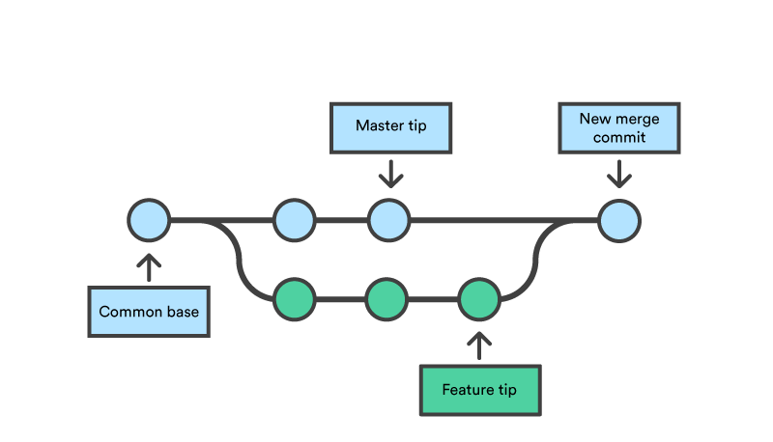
What is a Branch?
Branches provide a way for you to keep separate streams of development apart.
The main branch is called the master.
When completed, branches are merged back into master or wherever they were branched from.
Notes:
While this can be useful when you’re working alone, it’s almost essential when you’re working on team.
Imagine that I’m working in a small team and have a feature to add to the project. While I’m working on it, I don’t want to add my changes to master as it still doesn’t work correctly and might mess up my team members.
I could just wait to commit the changes until I’m completely finished, but that’s not very safe and not always practical. So, instead of working on master, I’ll create a new branch.
Branches can be merged when completed.

Slide 8
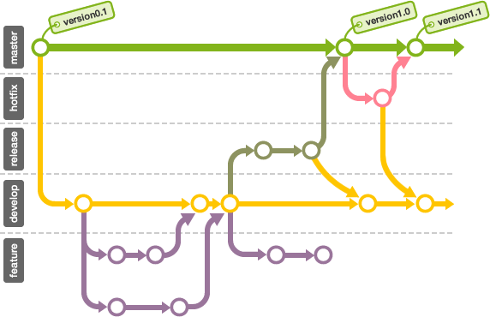
Git Workflow

Slide 9
Learning Git Commands
Here are some good Git commands to know:
Create / initialize a Git repository: $ git init
Create a branch named branch_name: $ git branch branch_name
Switch to branch branch_name: $ git checkout branch_name
Add file to staged commit: $ git add file_name
Create a commit with message message: $ git commit -m “message”
List all new or modified files: $ git status
For more commands check out this cheat-sheet: https://github.github.com/training-kit/downloads/github-git-cheat-sheet.pdf
Notes:
Just going to breeze through these. These aren’t expected to be memorized, just an introduction. They will be learned through usage.

Slide 10
Some Practice Before We Continue
https://learngitbranching.js.org is a great visual resource for learning Git.
Go to the website and complete the “Introduction Sequence”.
This will review some of what we’ve discussed.
You are welcome to continue through these levels during the lunch break or other free time. Git is a fantastic resource to learn!

Slide 11
Using the Command Line
Here are some good commands to know:
Print working directory: $ pwd
Move to the directory directory_name: $ cd directory_name
List contents of directory: $ ls (Mac) $ dir (Windows)
Output contents of file_name: $ cat file_name
For more commands check out this cheat-sheet:
https://www.git-tower.com/blog/command-line-cheat-sheet/ (Mac)
https://netseedblog.com/windows/windows-command-line-cheat-sheet-an-introduction-to-batch-scripting/ (Windows)
Notes:
In order to use Git commands, you should know how to maneuver through your computer using the terminal or a Windows equivalent.
So before we continue with Git, we’re going to learn how to work with the command line.
If you use “..” it will refer to the parent directory.

Slide 12
Install Git
First check if git is installed. Open terminal and type:
$ git --version
If git is not installed on your machine, you can download it here at: https://git-scm.com/downloads
Make sure your information is correct. In terminal type: $ git config --list
To update your name: $ git config --global user.name “your_name”
To update your email: $ git config --global user.email “your_email”

Slide 13
Let’s Get Our Robotics Repo Set Up
Head over to https://github.com/mgiglia92/Robotics-Crash-Course, hit clone and then download zip.
Once the zip is downloaded, move the folder wherever you want (and rename it if you’d like). This will be the location of our local Git repository.
Open the command line and move to the folder above.
Once in the folder, initialize a new Git repository using: $ git init

Slide 14
Testing Out Our New Repo
Let’s start off by staging all our files to be tracked. Type: $ git add . $ git commit -m “your_message”
Now, let’s practice what we’ve learned:
Make a new branch called “working”.
Make a change on that branch and commit it.
Switch back to the master branch and see if the changes are there.
On branch master, merge the “Working branch” with: $ git merge working

Slide 15
Now to Set Up GitHub
Head over to https://github.com and create an account.
Create a new repository on your GitHub.
Do NOT initialize it with a ReadMe, licence, or gitIgnore file.
Now we need to connect your local Git repository to GitHub:
If you go to your GitHub repository, it will give you an HTTPS link (it may be under Clone).
Copy that link and then navigate to the Git repository in terminal / bash. Type: $ git remote add origin your_url
Use $ git remote -v to verify that it succeeded.
Notes:
You can name it whatever you want: “Summer STEM”, “Robotics”, etc.

Slide 16
Setting Up GitHub Continued...
To push all of your files to GitHub type: $ git push -u origin master
Your local Git repository should now be connected to and up to date with your GitHub repository.
Remember: $ git add file_name $ git commit “message” $ git push
Notes:
Once you push, check GitHub to see that all of the files are there.

Slide 17
